Slide 1

Zoning
Presented by Jessica Logothetides
Assistant Civil Prosecutor
Office of the Stark County Prosecutor- Kyle L. Stone

Slide 2

Zoning
Zoning is the legislative method of regulating land use by a political subdivision (city, village, township, or county) into districts and the enactment of local regulations to control the buildings and uses within the districts.
The purpose of zoning is to regulate land use to minimize property disputes and that land development can proceed in an appropriate manner.
  Everybody wants zoning for their neighbor.

Slide 3
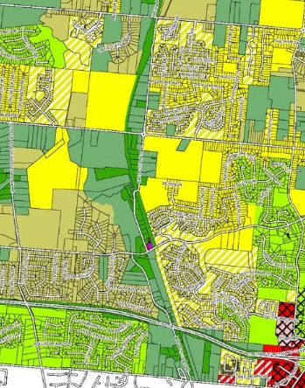
Basic Zoning Concepts
Zoning Resolution
  Lays out the exact regulations. Zoning codes typically establish several applicable zone districts in the community, the uses allowable in each zone (e.g. residential, commercial, industrial), requirements for setbacks, parking, and other site layout elements.
    Also includes information on procedures for zoning applications, appeals, variances etc.
Zoning Map
  Color-coded map that shows the locations of zone districts in the community.
Comprehensive Plan
  Long-term plan that guides all aspects of a community’s development over the next 20 or 30 years. A comprehensive plan serves as the basis for zoning regulations, and describes existing conditions and goals for housing, economic development, transportation, land use, public facilities, and the natural environment.

Slide 4

Enforcement of Zoning Regulations
For the purpose of enforcing the zoning regulations, the board of township trustees may:
  provide for a system of zoning certificates
  establish and fill the position of township zoning inspector
    Responsibility is to enforce the zoning resolution
    Zoning Resolution must have sufficient specificity, so the zoning inspector does not operate with excessive discretion.

Slide 5
Powers of township board of zoning appeals
The Board of Zoning Appeals provides a venue to property owners with unique conditions related to their property, who are seeking relief from the strict requirements of the zoning resolution.
R.C. 519.14
  Hear and decide appeals where it is alleged there is error in any order made by an administrative official in the enforcement of R.C. sections 519.02-519.25, or of any resolution
  To hear and decide requests for variances from zoning resolution
  To hear and decide requests for conditional uses
  Revoke an authorized variance or conditional zoning certificate granted for the extraction of minerals
    Township remedies for violation of other conditional use permits and variances are limited to enforcement actions in court.

Slide 6
Variances
Minor departure or exception from the strict rule or literal enforcement or interpretation of zoning provision.
Variance always relate to individual hardship peculiar to the property for which a variance is sought.
2 Types
  Use
  Area

Slide 7
Use Variance
A use variance allows a use of land that is not permitted in the district in which the property is placed.
  Example- if in a single-family district that does not allow a dentist office, a request for a variance to allow a dentist office is a request for a use variance.
Standard is unnecessary hardship
  Whether landowner unable to use the property for the purposes for which it is zoned, landowner deprived of the beneficial use of the land. In effect the restriction amounts to a taking.
  Whether the hardship is self-created
  Whether the variance would have an adverse impact on the rights of adjacent owners/community
  Whether the variance would have an adverse impact on public health, safety, or general welfare
  Whether the variance is consistent with general spirit and intent of zoning resolution

Slide 8
Area Variance
Area variance involves an exception from such requirements as yard, lot, height, setback, etc.
Standard is practical difficulties (lesser standard than unnecessary hardship)
Duncan factors to be considered include:
  would the property yield a reasonable return without the variance;
  is the variance substantial;
  will the essential character of the neighborhood be substantially altered or adjoining properties suffer a substantial detriment;
  will the variance adversely affect governmental services;
  did the owner purchase the property with knowledge of the zoning restriction;
  can problem be solved by some manner other than granting of a variance;
  whether the spirit and intent behind the zoning requirement would be observed and substantial justice done by granting the variance.

Slide 9
Conditional Uses
Conditional uses are allowed in the zoning resolution, but they are uses that require an administrative hearing for approval.
In issuing a conditional zoning certificate, BZA is governed by the terms and conditions imposed by the zoning resolution.
BZA cannot issue a zoning certificate for a permit that does not conform to applicable zoning regulations.
Resolution must provide standards that are clear to guide the board in the exercise of its authority.

Slide 10
Non-conforming Uses
Nonconforming uses arise when a legal existing use, or use formerly permitted by a prior zoning resolution, are no longer allowed under a new resolution.
3 regulatory considerations
  Prohibit retroactive application of zoning ordinance.
  Address abandonment or interruption of use.
    In townships any nonconforming use that is “voluntarily discontinued for 2 years or more” must thereafter be used in conformity with the applicable zoning ordinance.
  Provide that legislative bodies must allow for reasonable completion, restoration, reconstruction, extension, or substitution.

Slide 11
To Summarize….
A permitted use in a zoning district is allowable by right.
A nonconforming use is a property use that existed prior to current zoning regulations and is allowed to continue under a grandfather clause.
A variance allows the development of property in a manner which the zoning regulation would not otherwise permit, provided the circumstances of the property satisfy the proper standard (unnecessary hardship/practical difficulties).
A conditional use, which is a legitimate use under the resolution, but is granted subject to meeting specified conditions as outlined in the township zoning resolution.

Slide 12

The Board of Zoning Appeals
The BZA is an administrative board that is quasi-judicial in nature.
  Operates more like a court:
    Notice
    Administer oaths
    Hearing
    Opportunity to introduce evidence (cross-examine of witnesses)
    Right to appeal to a court
  Private deliberation

Slide 13
CONDUCTING THE HEARING
Call meeting to order
Keep in mind: be prepared for an appeal and understand the importance of a record
Ground rules
Order or presentation, formality, recording, etc.
Administer Oaths
Testimony-allow all persons to testify and allow for cross-examination
General Format
Chairperson announces application
Applicant presents case/evidence
Opponents present arguments/evidence
Applicant presents rebuttal
Board deliberates and renders decision
Conclusion of fact supporting the decision

Slide 14
Ethical Considerations
Issues to consider in maintaining the public trust and insuring fairness in the process include:
  (a) conflict of interest; and
  (b) ex parte communications.
No board member should vote or take any official action in violation of Ohio ethics law.
  For example-if the neighbor of a board member has requested a zoning variance that, if granted, will increase or decrease the value of the board member’s property, the board member is prohibited from voting on the variance.
    Recusal
Ex parte communications are communications that could be seen as an attempt to influence a decision-making official off the record and out of the presence of other parties.
  Board members are to refrain from discussing official matters of the Board with the public or with any applicant outside of the regularly scheduled meeting of the Board

Slide 15
Court Action
Landowners adversely affected by the BZA can appeal the decision to the court of common pleas.
  The common pleas court will overturn the decision of the BZA if the decision was unconstitutional, illegal, arbitrary, capricious, unreasonable, or unsupported by the preponderance of substantial, reliable, and probative evidence on the record.
  Filing of appeal with court suspends further action by BZA.
Worried about having a decision challenged in court? The short answer to avoiding litigation is simple – you can’t.
  But you can strengthen the position of the BZA’s decision should it be challenged by following standard decision making processes and proper procedures.
BZA must follow proper procedural rules= notice, hearing, timely etc.
BZA’s act in an administrative or quasi-judicial capacity.
  Present evidence, administer oath to witnesses, provide for examination and cross-examination, and set forth facts upon its decision.
  Findings, unbiased decision, complete record

Slide 16
Other Considerations
Preemption
  Political subdivisions (counties, townships, and municipalities) cannot enact zoning regulations that conflict with state law.
Agricultural Exemption
The Ohio Revised Code “confers no power” on townships:
  To prohibit the use of any land for agricultural purposes.
  To prohibit the construction or use of buildings or structures incident to the use for agricultural purposes of the land on which such buildings or structures are located.
    Including buildings/structures that are used primarily for vinting and selling wine and that are located on land any part of which is used for viticulture. R.C. 519.21(A)
Townships may regulate agriculture in some circumstances:
  In a platted subdivision approved under law or
  In an area of 15 or more lots approved under law that are contiguous to one another
  Then the township may regulate:
    Agriculture on lots of one acre or less.
    Buildings or structures incident to the use of land for agricultural purposes on lots greater than one acre but not greater than five acres by: set back building lines; height; and size.
    Dairying and animal and poultry husbandry on lots between 1 and 5 acres when at least 35% of the lots are developed. R.C. 519.21(B)
R.C. 519.21(C) also limits the regulation of specific activities such as farm markets/agritourism

Slide 17
Zoning Commission
Commission is responsible for the development of the zoning resolution and advises the board of township trustees on text and map amendments
Commission is composed of five members (appointed by the trustees) who reside in the unincorporated area of the township.
  Trustees may appoint 2 alternate members to take place of an absent regular member according to the procedures detailed by the resolution
Zoning Commission members shall be removable for nonperformance of duty, misconduct in office, or other cause by the board, upon written charges being filed by the board, after a public hearing regarding the charges, and after a copy served upon the member at least 10 days before the hearing.

Slide 18
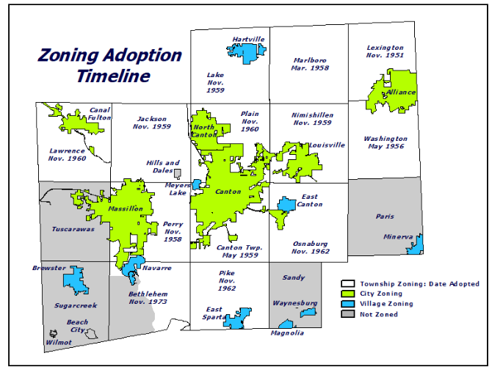
Zoning Amendments
  Requirements for zone change amendments are found in ORC 519.12
  These are not suggestions, but requirements for any proposals to change zoning districts (map amendments) or modify the township’s zoning resolution (text amendments).

Slide 19

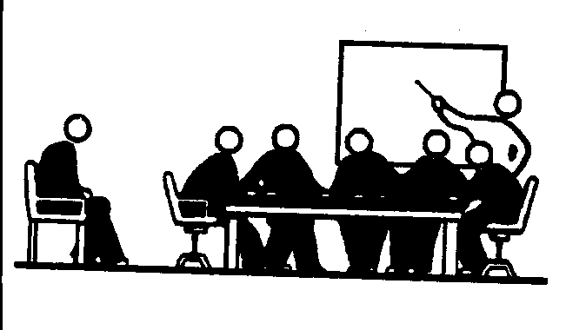



A
Clerk of Zoning Commission
Zoning Commission
B
Request submitted to Clerk of Commission
Receives the Request, Sends copy to RPC, Sets Public Hearing Date
Regional Planning Commission
C
Zoning Commission
D
Reviews Request, Submits Recommendation to Zoning Commission
Township Board of Trustees
Considers RPC Recommendation at Public Hearing; Submits Recommendation to Township Trustees
E
Township Board of Trustees
Township Board of Trustees Considers Recommendation at Public Hearing
F
G
Electorate
Makes Its Decision To:
Deny
Modify
Approve
Note: Must be by majority vote
Request is Adopted Unless Votes File Referendum Petition
Note: Adapted from the Revised Code, State of Ohio. See Section 519.12 for more.

Slide 20
Initiation
Zoning
Commission
Processing
RPC
Zoning
Commission
Hearing
Trustee
Processing
Trustee
Hearing
Trustee Action
Property owner/Lessee files application
Zoning Commission
Begins process
RPC recommend approval, denial, or modification
Zoning Commission
Public hearing
Township
Trustee
process
Township Trustee
Public hearing
Township Trustee
Decision
Trustees pass resolution
Zoning commission motion
Initiation of an amendment may occur through any three methods:
By the motion of the zoning commission
By the passage of a resolution by the board of township trustees subsequently certified to the zoning commission
By filing with the commission of an application by one or more of the owners or lessees of property within the area proposed to be changed or affected by a proposed amendment

Slide 21
Initiation
Zoning
Commission
Processing
RPC
Zoning
Commission
Hearing
Trustee
Processing
Trustee
Hearing
Trustee Action
Property owner/Lessee files application
Zoning Commission
Begins process
RPC recommend approval, denial, or modification
Zoning Commission
Public hearing
Township
Trustee
process
Township Trustee
Public hearing
Township Trustee
Decision
Trustees pass resolution
Zoning commission motion
Zoning Commission must schedule a public hearing on the amendment not less than 20 days nor more than 40 days after the initiation of the amendment.
Zoning Commission must follow the Notice procedures set forth in the statute.
Within 5 days after the initiation of the amendment, Zoning Commission must submit a copy together with text and map to RPC.

Slide 22
Initiation
Zoning
Commission
Processing
RPC
Zoning
Commission
Hearing
Trustee
Processing
Trustee
Hearing
Trustee Action
Property owner/Lessee files application
Zoning Commission
Begins process
RPC recommend approval, denial, or modification
Zoning Commission
Public hearing
Township
Trustee
process
Township Trustee
Public hearing
Township Trustee
Decision
Trustees pass resolution
Zoning commission motion
RPC reviews the proposed amendment.
RPC transmits recommendation of approval, denial, or approval of some modification of the proposed amendment to the zoning commission.

Slide 23
Initiation
Zoning
Commission
Processing
RPC
Zoning
Commission
Hearing
Trustee
Processing
Trustee
Hearing
Trustee Action
Property owner/Lessee files application
Zoning Commission
Begins process
RPC recommend approval, denial, or modification
Zoning Commission
Public hearing
Township
Trustee
process
Township Trustee
Public hearing
Township Trustee
Decision
Trustees pass resolution
Zoning commission motion
At the advertised time, date, and place, the zoning commission shall conduct a public hearing on the proposed amendment.
Recommendation of RPC shall be considered at the public hearing.
Within 30 days after the hearing, zoning commission must recommend approval or denial, or approval of some modification of it and submit such recommendation together with the motion, application, or resolution, the texts and maps, and recommendation of RPC to Township Trustees.

Slide 24
Initiation
Zoning
Commission
Processing
RPC
Zoning
Commission
Hearing
Trustee
Processing
Trustee
Hearing
Trustee Action
Property owner/Lessee files application
Zoning Commission
Begins process
RPC recommend approval, denial, or modification
Zoning Commission
Public hearing
Township
Trustee
process
Township Trustee
Public hearing
Township Trustee
Decision
Trustees pass resolution
Zoning commission motion
Board of Township Trustees must schedule a public hearing within 30 days after receipt of the zoning commission’s recommendation.
Board of Township Trustees must follow the Notice procedures set forth in the statute.

Slide 25
Initiation
Zoning
Commission
Processing
RPC
Zoning
Commission
Hearing
Trustee
Processing
Trustee
Hearing
Trustee Action
Property owner/Lessee files application
Zoning Commission
Begins process
RPC recommend approval, denial, or modification
Zoning Commission
Public hearing
Township
Trustee
process
Township Trustee
Public hearing
Township Trustee
Decision
Trustees pass resolution
Zoning commission motion
At the advertised time, date, and place, the Board of Township Trustees shall conduct a public hearing on the proposed amendment.

Slide 26
Initiation
Zoning
Commission
Processing
RPC
Zoning
Commission
Hearing
Trustee
Processing
Trustee
Hearing
Trustee Action
Property owner/Lessee files application
Zoning Commission
Begins process
RPC recommend approval, denial, or modification
Zoning Commission
Public hearing
Township
Trustee
process
Township Trustee
Public hearing
Township Trustee
Decision
Trustees pass resolution
Zoning commission motion
The Board of Township Trustees must adopt, deny, or adopt some modification of the township zoning commission within 20 days after their public hearing. A majority vote is required if the zoning commission’s recommendation is denied or modified.
If the amendment is adopted, it becomes effective in 30 days UNLESS within 30 days after adoption, there is presented to the board of township trustees a referendum petition.
Within 5 days after amendments effective date, trustees shall file the text and maps of the amendment with the County Recorder and RPC

